Slide 1

ASSIGNMENT GUIDELINES
Make the changes in the PPT as you solve the parts
This file contains the template for all the parts of the project.
Check the instructions added in the note section of every slide for clarity.
Don’t move around any image or text box
If you require more/lesser elements, be careful when you copy/delete the existing ones.

Slide 2
ASSIGNMENT Name: KUNAL KAKARA
Problem Statement The sales pipeline conversion percentage at TechnoServe (a tech SaaS startup) has dropped from 35% at the end of last fiscal (FY 2017-18) to 25% at present.
Assignment Objective
Understand the problem, come up with a hypothesis for low conversions faced by TechnoServe, and analyse the dataset provided to arrive at possible solutions to increase it.
Notes:
Problem Statement

Slide 3
Understanding the Problem Sales Pipeline Conversion at a SaaS Startup
Who?
TechnoServe (a tech SaaS startup)
What?
Sales pipeline conversion
When?
End of last fiscal (FY 2017-18)
Where?
Among the possible customers or the leads generated by the company
How?
Lack of features
Outdated technology/product
Sales team are not skilled enough to convert into Potential Customer.

Slide 4
Understanding the Problem Sales Pipeline Conversion at a SaaS Startup
Situation
1. Is the company generating revenue through other means?
2. Is the company still profitable?
3. What are the different products offered by the company?
4. How much clients does the techno serve has?
Problem
How does the Techno Serve identify the leads in the market?
How much time does it take to convert the customer into a client?
Are there any repeated potential customers or do we have to find new customers every time?
Implication
What is the impact of the low sales on the profit of the company?
Will the low sales make the company difficult to sustain?
Will the cash flow of the company affected?
Need-Payoff
What is the percent of the growth of revenue expected after solving the problem?
Will it help to capture the market share?
Notes:
Provide at least three questions under each branch.

Slide 5
Formulating Hypotheses Sales Pipeline Conversion at a SaaS Startup
Framework Used
5 C Frame Work
Reason for using the selected framework
The 5C framework will help to understand the internal and external environment in which the firm is operating.
How you have used the framework here
5C framework will help to understand each branch individually. Later it will help to drill down each branch by formulating the hypothesis and help us find the root cause analysis impacting the sales conversion.
Notes:
All the frameworks that are used should be mentioned.
A suitable reason is a must to provide here

Slide 6
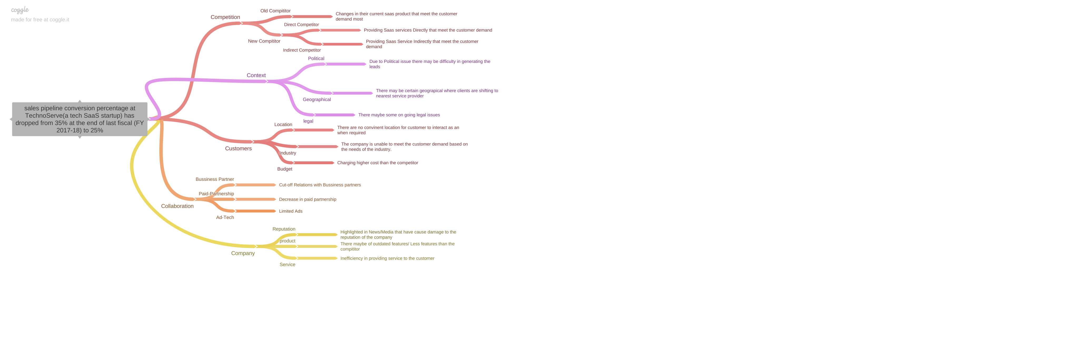
Formulating Hypotheses Sales Pipeline Conversion at a SaaS Startup
Notes:
Use the “download as” feature of Coggle if you are using the tool.
Provide one image with complete tree along with separate elements where the text is readable.
Copy the slide if you require more space

Slide 7
Formulating Hypotheses Sales Pipeline Conversion at a SaaS Startup
Branch 1
Problem: The sales pipeline conversion percentage at TechnoServe(a tech SaaS startup) has dropped from 35% at the end of the last fiscal (FY 2017-18) to 25%
Competition
a. Old Competitor
Hypothesis: There might be some changes in their current saas product that meet the customer demand most and therefore people are shifting to other service provider.
Branch 2
b. New Competitor
Hypothesis: There may be a new incoming competitor in the market which is providing the sales directly or indirectly
Notes:
Each branch must follow this naming pattern: Problem – Branch 1 – Sub-branch 1 – Sub-branch 2 – …… – Hypotheses
There must be minimum 10 hypotheses in total and at least 1 in each branch.

Slide 8
Formulating Hypotheses Sales Pipeline Conversion at a SaaS Startup
Branch 3
2. Context
Political
Due to some political issues, there may be difficulty in generating the leads or executing the campaign.
Branch 4
b. Geographical
Due to inefficiency in service providing clients may be shifting to the nearest service provider.
Notes:
Each branch must follow this naming pattern: Problem – Branch 1 – Sub-branch 1 – Sub-branch 2 – …… – Hypotheses
There must be minimum 10 hypotheses in total and at least 1 in each branch.

Slide 9
Formulating Hypotheses Sales Pipeline Conversion at a SaaS Startup
Branch 5
3. Customer
Budget
The TechnoServe company is charging a bit higher price than the competitor
Branch 6
b. Industry
The Technoserve might be unable to meet the required demands of the clients and industry.
Notes:
Each branch must follow this naming pattern: Problem – Branch 1 – Sub-branch 1 – Sub-branch 2 – …… – Hypotheses
There must be minimum 10 hypotheses in total and at least 1 in each branch.

Slide 10
Formulating Hypotheses Sales Pipeline Conversion at a SaaS Startup
Branch 7
4. Collaboration
Business Partner
Cut off relations with the Business Partner.
Branch 8
b. Ads
Decrease in ads which leads to make shortfall in awareness.
Notes:
Each branch must follow this naming pattern: Problem – Branch 1 – Sub-branch 1 – Sub-branch 2 – …… – Hypotheses
There must be minimum 10 hypotheses in total and at least 1 in each branch.

Slide 11
Formulating Hypotheses Sales Pipeline Conversion at a SaaS Startup
Branch 9
5. Company
Reputation
Highlighted in media and news which have cause damage to the reputation on the company
Branch 10
b. Product/Service
There may be outdated features or inefficiency in providing the service.
Notes:
Each branch must follow this naming pattern: Problem – Branch 1 – Sub-branch 1 – Sub-branch 2 – …… – Hypotheses
There must be minimum 10 hypotheses in total and at least 1 in each branch.

Slide 12
Generating Insights Sales Pipeline Conversion at a SaaS Startup
Variable
B2B Sales Medium
Count of B2B sales medium
Insights if any
There are very few online leads generated.
Pattern of Insight
Significant outlier
Notes:
Analyse the variables in the dataset, find the insights and mention the pattern of insights in the data. Make more copies of this slide if needed.

Slide 13
Generating Insights Sales Pipeline Conversion at a SaaS Startup
Variable
City
B2B Sales Medium
Insights if any
The Highest number of leads were generated in Mumbai City through the Marketing and Enterprise Sellers channel, which is nearly 12.93% & 12.56% respectively.
Pattern of Insight
1. Surprising Extreme
Notes:
Analyse the variables in the dataset, find the insights and mention the pattern of insights in the data. Make more copies of this slide if needed.

Slide 14
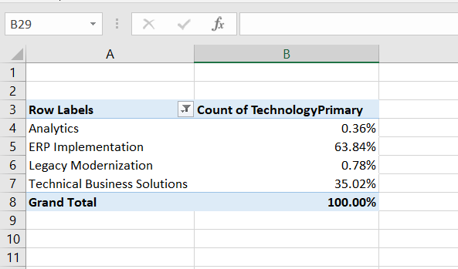
Generating Insights Sales Pipeline Conversion at a SaaS Startup
Variable under consideration:
Technology Primary:
In Technology Primary ERP Implementation is performing best among all others that is about 63.84%.
The numbers state that the clients are more interested in ERP implementation and potential revenue can be generated by focusing on it.
Notes:
For each variable that produced an interesting insight, explain you analysis bit here – the results you got from excel and the necessary visualisations. Note: it is compulsory for you to mention the results of the analysis on these variables - 'Technology Primary', 'B2B Sales Medium', 'Client Revenue Sizing', 'Opportunity Sizing' and 'Business from Client last year’.

Slide 15
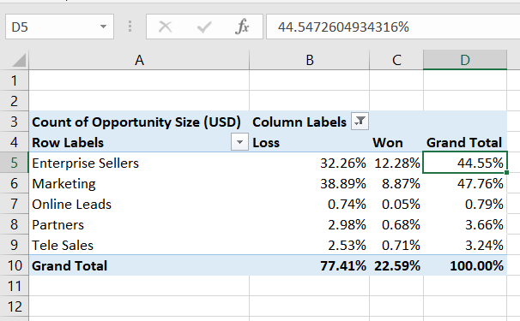
Generating Insights Sales Pipeline Conversion at a SaaS Startup
Variable under consideration:
B2B sales Medium
In B2B sales medium Enterprise sellers and Marketing modes, the medium is the best performing at 44.75% and 47.76% respectively.
Further Enterprise sellers have a 12.28% win rate and marketing has an 8.87% win rate.
The leads generated by Enterprise Sellers have more capability to convert leads into potential customers whereas Through Marketing medium it is able to generate the leads but inefficient to convert into a potential customers.
Notes:
For each variable that produced an interesting insight, explain you analysis bit here – the results you got from excel and the necessary visualisations. Note: it is compulsory for you to mention the results of the analysis on these variables - 'Technology Primary', 'B2B Sales Medium', 'Client Revenue Sizing', 'Opportunity Sizing' and 'Business from Client last year’.

Slide 16
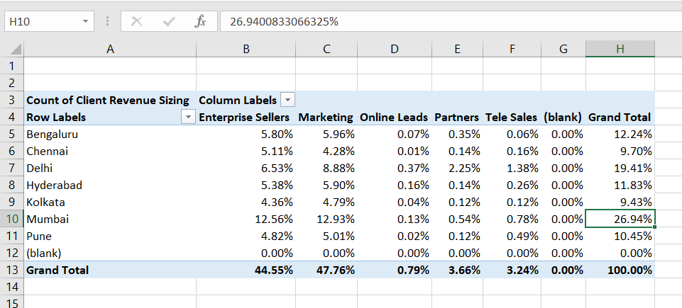
Generating Insights Sales Pipeline Conversion at a SaaS Startup
Variable under consideration:
3. Client Revenue Sizing
Client Revenue Sizing can be mainly obtained from Mumbai and Delhi, particularly from Enterprise sellers and Marketing
The count of revenue sizing from Mumbai city is 26.94% and from Delhi city is 19.41%.
Marketing
Notes:
For each variable that produced an interesting insight, explain you analysis bit here – the results you got from excel and the necessary visualisations. Note: it is compulsory for you to mention the results of the analysis on these variables - 'Technology Primary', 'B2B Sales Medium', 'Client Revenue Sizing', 'Opportunity Sizing' and 'Business from Client last year’.

Slide 17
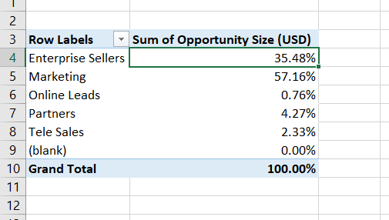
Generating Insights Sales Pipeline Conversion at a SaaS Startup
Variable under consideration:
4. Opportunity Sizing
In B2B Medium sales medium marketing has a big opportunity sizing nearly 57.16%
The Marketing count has a good opportunity sizing followed by Enterprise seller.
Notes:
For each variable that produced an interesting insight, explain you analysis bit here – the results you got from excel and the necessary visualisations. Note: it is compulsory for you to mention the results of the analysis on these variables - 'Technology Primary', 'B2B Sales Medium', 'Client Revenue Sizing', 'Opportunity Sizing' and 'Business from Client last year’.

Slide 18
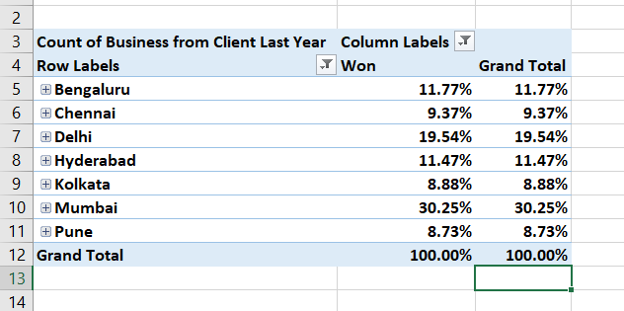
PART III A : Generating Insights Sales Pipeline Conversion at a SaaS Startup
Variable under consideration:
5. Business from a client last year
Business from a client last year was done specifically from Mumbai and Delhi 30.25% and 19.54% respectively
Notes:
For each variable that produced an interesting insight, explain you analysis bit here – the results you got from excel and the necessary visualisations. Note: it is compulsory for you to mention the results of the analysis on these variables - 'Technology Primary', 'B2B Sales Medium', 'Client Revenue Sizing', 'Opportunity Sizing' and 'Business from Client last year’. Make more copies of this slide if needed.

Slide 19
Generating Insights Sales Pipeline Conversion at a SaaS Startup
Recommendations
Mumbai and Delhi are the top cities where major clients are located
The leads Generated are mostly from Marketing and Enterprise sellers but the problem is that they are unable to convert them into potential customers.
The clients are more interested in ERP Implementation and Technical Business Solutions than the other solutions offered
Corresponding Insights
1. Significant Outlier
2. Unknown Result
3. Unknown Result
Notes:
For each recommendation explain the insights that form the reasoning for giving that recommendation. Make more copies of this slide if necessary.

Slide 20
Presenting Findings Sales Pipeline Conversion at a SaaS Startup
The Problem of low sales can be tackled by looking for customers who are interested in ERP implementation and Technical solutions.
Demand for ERP Implementation and Technical solutions is 63.84% and 35.02%
In B2B Sales The leads are mainly generated by the Marketing and ERP Implementation
Business was done from three major cities Mumbai, Delhi, and Bengaluru
The leads generated by the Marketing and Enterprise seller are 47.60% and 44.68% for the ERP Implementation and Technical solutions.
The total leads generated by the ERP Implementation is 44.55% and leads won are 12.28% whereas in marketing 47.76% leads were generated and the leads won are 8.87%
The Major leads generated by B2B sales are from these Three Cities
Notes:
You are free to use the elements and boxes mentioned previously. Make sure you’re using the pyramid principle, data visualization, visual design principle and storyboarding concepts to design these slides.

Slide 21
Presenting Findings Sales Pipeline Conversion at a SaaS Startup
Story Telling
To Generate the potential revenue three cities should mainly be focused on Delhi, Mumbai, and Bengaluru. The Clients are mostly interested in ERP Implementation and Technical Business Solutions.
The B2B sales medium that generates the most leads are Marketing and Enterprise sellers.
Conversion of leads is a bit difficult but Skilled Teams and Meeting the client demands would lead to the conversion of more customers into potential customers.
Notes:
You are free to use the elements and boxes mentioned previously. Make sure you’re using the pyramid principle, data visualization, visual design principle and storyboarding concepts to design these slides.

Slide 22
Presenting Findings Sales Pipeline Conversion at a SaaS Startup
I conclude that the assumed hypothesis of Competition in the old competitor or new competitor is providing some of the product solutions in a more efficient manner therefore there is only demand for ERP Implementation and Technical Business solutions.
The assumed hypothesis of Collaboration there are some cutoff relations with a business partner therefore we have to rely on Marketing and Enterprise sellers.
Notes:
You are free to use the elements and boxes mentioned previously. Make sure you’re using the pyramid principle, data visualization, visual design principle and storyboarding concepts to design these slides.

